Slide 1
Run Cypress Tests & Reporting.

Slide 2
Chapter 5: Run Cypress Tests & Reporting.
1.Running Cypress From the Terminal.
All test case
Single test case.
Specific Browsers
2.Running Cypress From Test Runner
3.Running Cypress From Dashboard
4.Capture Screenshots, Record video.
5.HTML Reporting.

Slide 3
Running Cypress From the Terminal.
Running the test cases in UI mode is more suitable when the development of test cases is in progress.
But once the development is complete, the user would want to run the test cases in headless mode.
Because running test cases in UI are always slower than running in headless mode.
Cypress fulfils all these needs and provides ways to execute the test cases from CLI.
All test case
npx cypress run.
Running single test case.
npx cypress run --s cypress run --spec "path/to/your/test-file.spec.js"
Running with Specific Browsers
npx cypress run --browser <browser-name>

Slide 4
Running Cypress From Test Runner
To run with cypress test runner. Follow the following steps.
Run this command in terminal
npx cypress open
Select test Type.
End-To-End
Componet
Choose Browser.
From list of browser.
Select test case.
From list of test case

Slide 5
Running Cypress From Dashboard
Cypress Dashboard is a web-based component that provides various features related to projects and test runs in Cypress.
Cypress dashboard is helpful.
Test Stats
Stack Trace
View Screenshots
View video
Parallel Tests
Grouping Tests,

Slide 6
How to open cypress
Two way to open cypress
1. In Test Runner app.
npx cypress open
node_modules/.bin/cypress open
2. in Terminal.
npx cypress open
Once the cypress runner is open, new folder named “cypress”. created

Slide 7
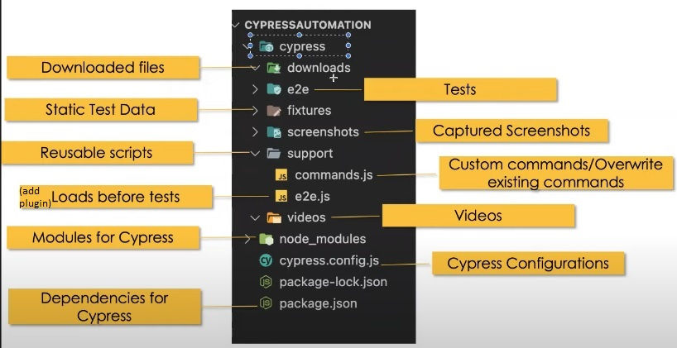
Project folder

Slide 8
Write First test code.
describe('My First Test', () => {
it('Does not do much!', () =>
{
expect(true).to.equal(true)
})
})
we can yous arrow or Anomalous function to write describe or it.

Slide 9
https://www.tutorialspoint.com/cypress/index.htm
https://toolsqa.com/cypress-tutorial/
https://docs.cypress.io/examples/tutorials
https://mindmajix.com/cypress-tutorial

